Slide 1
VIROIDS

Slide 2
Upto 70% of the nucleotides in the genome RNAs are extensively base paired due to which they appear rod shaped or dumb- bell shaped under electron microscope instead of circular shaped.
Nucleotide sequence analysis of viroid RNA shown that no proteins are encoded by either genome or antigenome sense RNA.

Slide 3
introduction
Discovered by Theodor O.Diener ,the Agricultural Research Service plant Pathologist in 1971 (MARYLAND).
Novel agents of disease in plants.
Genome consists of single circular ssRNA molecule with no protein component.
Smallest self replicating pathogens known.
Genome size ranges from 246-400 nucleotides.

Slide 4
Cause diseases through RNA interference with essential host cell mechanism.
Transmitted through vegetative propagation of the host, by seed, by aphids or through mechanical damage and overcome the problem of there being no receptor for naked RNA.

Slide 5
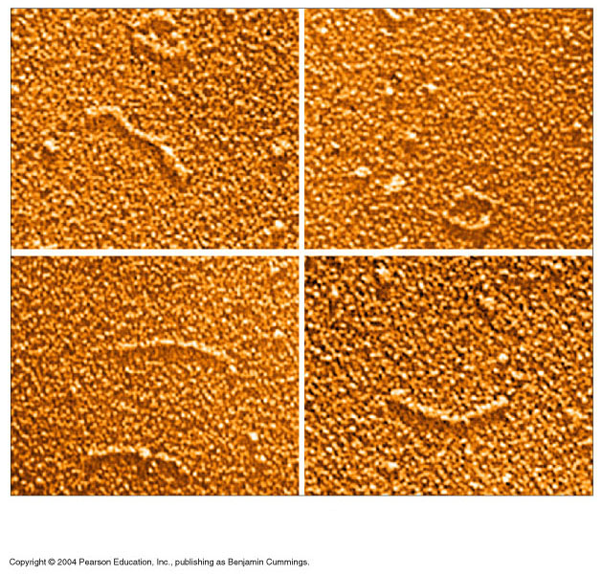
Electron Micrograph of Viroid

Slide 6
classification
FAMILY:- Pospiviroidae
RNA of 350 nucleotide with a central conversed sequence.
Replicated in the nucleus by host’s DNA dependent RNA polymerase II.
Many members, eg:- Potato spindle tuber viroid and coconut cadang cadang viroid.

Slide 7
FAMILY:-Avsunviroidae
RNA of 246 nucleotides without central conversed sequence.
Replicate in chloroplast.
Undergo self cleavage via hammerhead ribozyme.
Eg:- Avacado sunblotch viroid

Slide 8
Replication:
The covalently closed ssRNA genome of plant viroids do not encode any proteins so there is no positive sense mRNA made.
Conventionally, the strand of RNA which is most abundant in the infected cells is termed as positive sense.
When the naked RNA enters the cell it must be replicated by proteins already present in the cell.

Slide 9
The enzyme responsible for replication is the host cell DNA dependent RNA polymerase.
Its not known how this enzyme functions on RNA template but may be due to extensive base pairing structure of genome RNA.
Replications begin by adopting rolling circle mechanism.

Slide 10
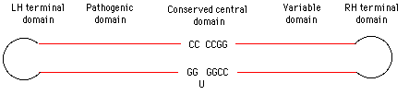
Replication in Pospiviroidae & Avsunviroidae
Pospivirodae have central conserved region where as Avsunviroidae do not have CCR.

Slide 11
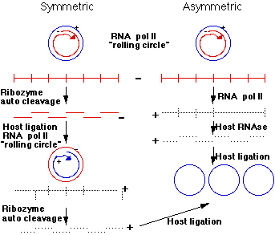
SYMMETRIC & ASYMMETRIC REPLICATION.

Slide 12
Avsunviroids probably replicate via a symmetric rolling circle mechanism.
Pospiviroids probably use an asymmetric mechanism.
+ve infecting circular RNA strand of a viroid serves as a template to make a large linear multimeric -ve strand.
Host RNA pol II is probably the enzyme which does this. Pospiviroids with an asymmetric replication pathway then make +ve RNA from this long linear molecule.
A host RNAse activity cleaves the +ve strand into unit viroid lengths. This molecule is then ligated to form a circular viroid.

Slide 13
2. Cytopathic effect
Various effects of viroid infection on cellular structures have been reported. For ex in some infections, changes have been observed in membranous structures called “plasmalemma”. Corrugation and irregular thickness in cell walls of viroid infected tissues have been observed

Slide 14
Biochemical changes
Viroid infection appears to cause no gross changes in host nucleic acid metabolism. In contrast marked changes in amount of various host proteins have been described in infected tissue. For ex a 140 KDa protein. The most dramatic effect is the increase in a 140 KDa host protein in tomatoes infected with viroids. Significant changes have been found in viroid infected tissues.

Slide 15
Pathology of Viroids
Macroscopic disease symptoms-
Viroids infect both dicotyledonous and monocotyledonous plants. Symptoms produced by viroids disease are identical to that of viral diseases. These include stunting, mottling, leaf distortion and necrosis.

Slide 16
VIROID DISEASES
Potato spindle tuber viroid (PSTVd)
First viroid to be identified.
natural hosts are potatoes and tomatoes.
Common symptoms include # reduction in plant size
# changes in plant growth habit ( characterized by uprightedness)

Slide 17
Affected tubers are small, narrow and spindle like.
Some tubers develop konbs and swellings and even get cracked during much infection.

Slide 18
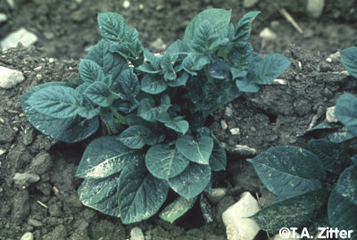
. Foliar infection of potato spindle tuber viroid (PSTVd) showing stiff upright growth habit.
.

Slide 19
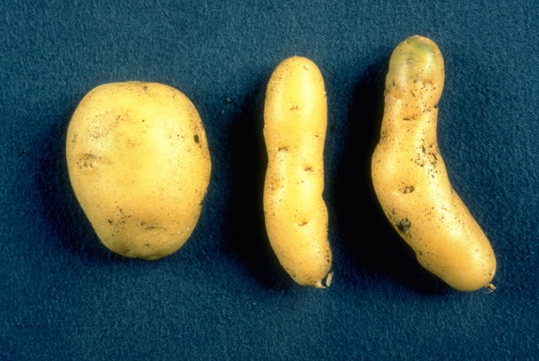
. Tuber infection of potato spindle tuber viroid (PSTVd) showing spindle shaped tubers (right)

Slide 20
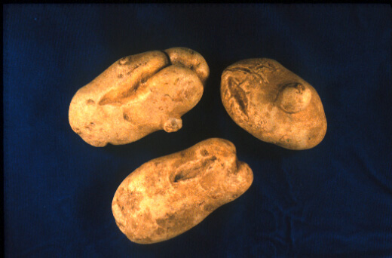
Tuber infection of potato spindle tuber viroid (PSTVd) showing cracked tubers

Slide 21
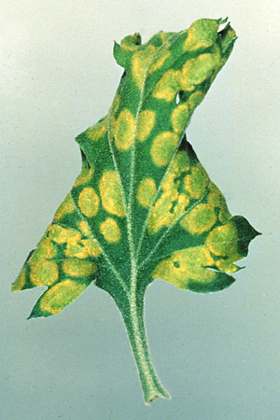
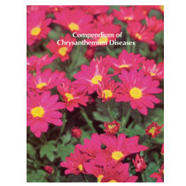
CHRYSANTHMUM STUNT

Slide 22
Avacado sunblotch viroid (ASBV)
Important disease affecting Avacado trees.
smallest known viroid that infects plants and is transmitted by pollen and infected seeds or budwood,
Symptoms include lower yeild , poor fruit quality,bleached veins and petioles.

Slide 23
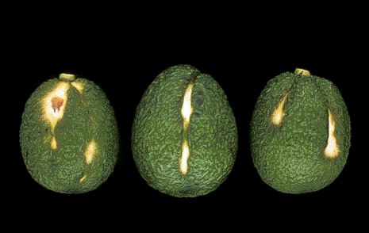
Fruit of Avacado tree affected by Avacado sun blotch viroid

