Slide 2
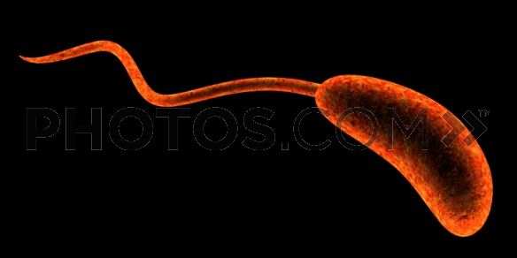
CHOLERA

Slide 3
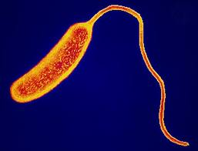
MORPHOLOGY AND IDENTIFICATION
Vibrio cholerae :comma shaped,curved and rod shaped bacteria of 2-4 µm long.
motile by means of a polar flagella.
colonies: convex ,smooth ,round, opague
V.cholerae and other Vibrios
grow well at 37°c on
many diff. media .

Slide 4
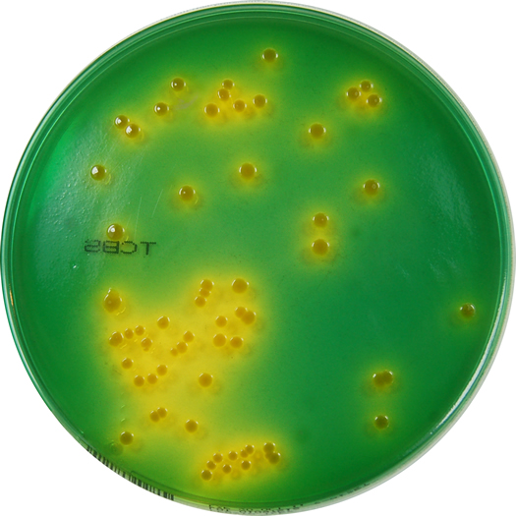
V.cholerae grow best on Thiosulphate-citrate-bile-sucrose(TCBS)agar on which it produce yellow colonies that are readily visible against the dark green background of the agar.

Slide 5
Vibrios grows at a very high ph(8.5-9.5) and are readily killed by acid. Therefore infective dose 50 is very high
CHOLERA GROWTH
CHARACTERISTICS
V. Cholerae ferments both sucrose and mannose, oxidase +ve, Most of the vibrios are halotolerent and NaCl often stimulates their growth
Vibrios grows on media which containing 6% NaCl.
Therefore alkaline water of pH 9 with high salt is used as transport medium, even sterile sea water is a good enough medium for transport and maintaining viability.

Slide 6
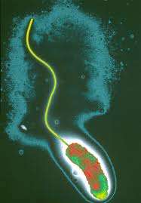
ANTIGENIC STRUCTURE AND BIOLOGICAL CLASSIFICATION
V. cholerae has O lipopolysaccharides that confer serologic specificity. There are at least 139 O-antigen groups.
V. cholerae strains of O-group 1 and O-group 139 cause classic cholera. Non –O1/non-O139 V. cholerae cause cholera like disease.
Antibodies to the O-antigen tend to protect laboratory animals against infection with V. cholerae.
The V. cholerae serogroups O1 antigen has determinants that make possible further typing :
1. Ogava
2.Inaba
3.Hikojima

Slide 7
Two biotype of epidemic V.cholerae are : Classic and E1 tor.
The E1 tor biotypes produces a hemolysin , VP +ve and are resistant to polymycin B.
V.cholerae O139 is very similar to V. cholerae O1 E1 tor biotype.
V.cholerae O139 does not produce the O1 lipopolysaccharide but has polysac capsule unlike O1 biotype.
(READ more about differences between E1 tor and classic biotype

Slide 8
VIBRIO CHOLERAE ENTEROTOXIN
produce a heat labile enterotoxin (MW-84000) -has two subunit A and B (chromosome encoded).
Ganglioside GM₁ -receptor for subunit B, which promotes the entry of subunit A into the cell.
Activation of subunit A, increase the level of intracellular cAMP and result in prolonged hypersecretion of water and electrolytes . There is increased Na-dependent Cl-secretion and absorption of Na and chloride is inhibited.
Diarrhae occurs –with resulting dehydration, shock, acidosis and death.

Slide 9
PATHOGENESIS AND PATHOLOGY
V.cholerae is pathogenic only for the humans .
ID 50= 10¹⁰ or more, when the vehical is water, because the organism are susceptible to acid . When the vehical is food id50 is as few as 10²-10⁴ because of buffering capacity of food .
The organism do not reach to the bloodstream but remains within the intestinal tract.

Slide 10
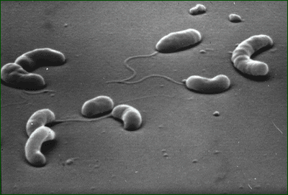
Virulant V.cholerae organisms attack the microvilli of the brush border of epithelial cell . There they multiply and liberate cholera toxin and perhaps mucinases and endotoxin.

Slide 11
CLINICAL FINDINGFS
About 60% of infections are asymptomatic with classic and about 75% with E1 Tor type .
IP=1-4 days.
Stools contains mucus , epithelial cells and large no. of vibrios (rice water stool) and no blood cells . There is a rapid loss of fluid and electrolytes , which lead to profound dehydration ,circulatory collapse.
The mortality rate without treatment is between 25% and 50%.
The diagnosis of a full blown case of cholerae presents no problem in the presence of an epidemic . However ,sporadic or mild cases are not readily differentiated from other diarrheal diseases.
The E1 Tor biotype tends to cause milder disease than the classic biotype .

Slide 12
An adult cholera victim. The hands show wrinkled skin, known as the "Washer Woman's sign" because the body has lost so much water that it cannot maintain cell turgor and the skin collapses.

