Slide 1
PRIONS

Slide 2
What are PRIONS?
Prions are infectious agents composed of protein in misfolded form.
initially thought to be viruses which replicated slowly within their hosts, but no nucleic acid found associated with infectious material.
Shown to be aberrant forms of normal cellular proteins which can induce changes in the shape of their normal homologs with catastrophic consequences for the host.
Discovered by STANLEY B.PRUSNER in 1982 and got Nobel Prize in 1998 for this contribution.

Slide 3
Normal form of protein called PrPc , while the infectious form is PrPSc.
Here ‘c’ refers to cellular or common PrP.
‘Sc’ refers to Scrapie, a prion disease occuring in sheep.
Structure of PrP is well defined but of PrP Sc is polydispersed and defined at a relatively poor level.

Slide 4
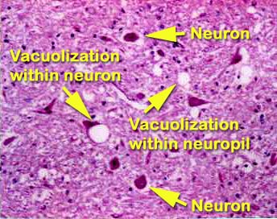
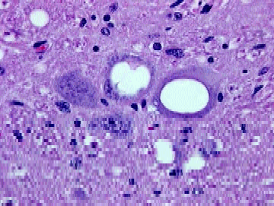
Brain Damage from Spongiform Encephalopathy
vacuole
Source: UC Davis School of Veterinary Medicine

Slide 5
Transmissible spongiform encephalopathies
Animals
  Bovine spongiform encephalopathy (BSE)
  Scrapie in sheep and goats
  Transmissible mink encephalopathy
  Chronic wasting disease of deer, elk
Humans
  Kuru
  Creutzfeldt-Jacob disease (CJD)
  Fatal familial insomnia (FFI)
  Gerstmann-Straussler syndrome (GSS)
TSEs are always fatal

Slide 6
Types of TSEs
Infectious
  e.g., kuru, BSE (mad cow disease), scrapie
  Spread by
    consumption of infected material
    Iatrogenic spread (organ transplant, esp. cornea)
    transfusion
Sporadic
  1-2 million infected worldwide, late in life
  Evidence mounting that some sporadic TSE is really result of infection
Familial
  Due to autosomal dominant mutation of PrP
  Inherited – at least 10-15% of total human TSE cases
Each of these can be transmitted experimentally

Slide 7
Kuru
Identified in New Guinea by Robert and Louise Glasse in 1950’s
1% of the Fore tribe was afflicted; mostly women, some children, few adult males
Symptoms: headache, joint pain, 6-12 weeks later- difficulty walking and death usually within 12 months, (always within 2 years)
Disease was of recent origin: ~1910-1920
Glasses suggested that endocannibalism was associated with disease

Slide 8
Australian government suppressed cannibalism among North Fore in early 1950’s
South Fore were convinced to discontinue the practice in 1959
Incidence of kuru among North Fore ceased ~ 5 years before South Fore; no child born since then has died of kuru
Carlton Gadjusek, scientist with NIH, inoculated chimps with brain extracts of kuru victims; all chimps died after 50 months
No unique antibodies were associated with disease, no virus particles or aberrant nucleic acids were identified
Gadjusek got Nobel Prize

Slide 9
Scrapie
An animal model was needed to study TSEs
Scrapie disease of sheep had many similarities to kuru in terms of symptomatology and etiology
Could be transmitted to hamsters and mice, kuru could not
Scrapie was used as first good animal model TSE
2 month incubation in rodents
Infectious agent purified 5000 fold
  Nuclease resistant
  UV and heat resistant
  Sensitive to protease (only at high levels) & protein denaturants

Slide 10
Major Contributors to the History of Prions
Glasses research in1950’s and 60’s
Carlton Gajdusek receive Nobel Prize in 1976 for proving transmissibility of Kuru
In 1982 Stanley Prusiner -concluded no NA, first named “proteinaceous infectious particles that resist inactivation by procedures that modify nucleic acids” as PRIONS-received Nobel Prize in 1997.

Slide 11
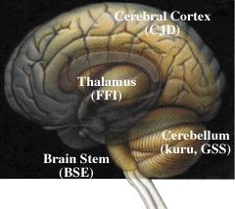
Different prions affect different parts of the brain
Cerebral cortex When the cerebral cortex is affected, the symptoms include loss of memory and mental acuity, and sometimes also visual imparement (CJD).
Thalamus Damage to the thalamus may result in insomnia (FFI).
Cerebellum Damage to the cerebellum results in problems to coordinate body movements and difficulties to walk (kuru, GSS).
Brain stem In the mad cow disease (BSE), the brain stem is affected.

Slide 12
Effect of prions on neural tissue
Convert PrPc into PrPSc
PrPc is readily digested by Protease K and can be liberated from the cell surface in vitro by enzyme phosphoinositide phospholipase (PI-PLC).
Play important role in cell-cell adhesion and intracellular signalling.
PrPSc has identical primary structure but different beta structures leading to resistance of protease cleavage.
Brain tissue collects PrPSc causing too much protein accumulation.
Distinguished by nerve cell death causing large vacuoles and plaques in brain tissue

Slide 13
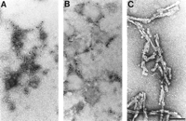
Electron Micrographs showing :
A. PrP Protein.
B. PrPSc Protein.
C. Prion rods composed of PrPsc.

Slide 14
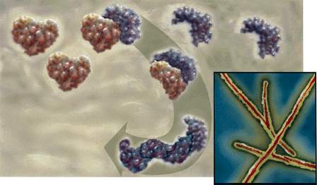


How do prions function? (prion hypothesis)
PrP^{c}
The prion protein exists in two forms. The normal, innocuous protein (PrPc) can change its shape to a harmful, disease-causing form (PrPSc). The conversion from PrPc to PrPSc then proceeds via a chain-reaction. When enough PrPSc proteins have been made they form long filamentous aggregates that gradually damage neuronal tissue. The harmful PrPSc form is very resistant to high temperatures, UV-irradiation and strong degradative enzymes.
PrP^{Sc}

Slide 15
PrPc | PrPsc
209 amino acid long (in humans), one disulfide bond, a molecular mass of 35–36 kDa and a mainly alpha-helical structure | 209 amino acid long (in humans), one disulfide bond, a molecular mass of 35–36 kDa Higher proportions of beta sheets
Protease Resistance: low | high
Heat resistance: low | high
Soluble: doesn’t forms aggregates | Insoluble, forms aggregates, form highly structured amyloid fibers, which accumulate to form plaques
 | Catalyze convertion of PrPc into PrPsc
Normal cellular protein involved in cell-cell adhesion and intracellular signalling | Role in SPEs

Slide 16
Prion biology
For a prion (PrP^{Sc}) to infect a host, the host must have a recognizable cellular form (PrP^{c}) of that prion
Generally, the closer the phylogenetic relationship between the donor host and the recipient, the greater the chance for infection, and the more rapidly symptoms occur
Level of accumulation of prion does not necessarily correspond to level of disease
Mice in which PrP^{c} copy is knocked out have altered sleep/wake cycles and circadian rhythm

Slide 17
Prions
First identified with “Spongiform encephalopathies”
Characteristics of infection:
  Loss of motor control
  Dementia
  Paralysis
  Encephalitis
  Widespread neuronal loss
Mode of transmission:
  Infectious (including diet, after surgical procedures, corneal transplants etc.)
  Hereditary (autosomal and dominant mutations)

Slide 18
Chemical Treatment:
Concentration
PSTV
Scrapie
(viroid)
(prion)
NH₂OH (hydroxylamine)
0.1-0.5mM
+
-
Psoralen (binds NA)
10-500µg/ml
+
-
Phenol
Saturated
-
+
SDS
1-10%
-
+
Zn2+
2mM
+
-
Urea
3-8M
-
+
Alkali
pH 10
(-)
+
KSCN
1M
-
+
Enzymatic Treatment:
RNAse A
0.1-100µg/ml
+
-
DNAse
100µg/ml
-
-
Proteinase K
100µg/ml
-
+
Trypsin
100µg/ml
-
+
+ = inactivated; - = no change in infectivity

Slide 19
Bovine spongiform encephalopathy (BSE)
“mad cow disease”
In Britain in the 1970’s, hydrocarbon-solvent extraction of meat and bone meal (MBM) used for cattle feed
In 1987, BSE emerged
disease Epidemiology suggested a prion disease, and MBM use was abandoned
BSE incubation period is ~5 years
Estimated that over 1,000,000 cattle were infected
In 1989, human consumption of bovine CNS tissue (thought to have the highest prion concentration) banned based on fears of transmission to humans
In 1996, a new type of CJD appeared in Britain and France; young patients (<40 years old) and different neuropathology

Slide 20
Evidence that BSE gave rise to vCJD in humans
Course of vCJD disease was 14 months rather than 4-6 month for CJD, suggesting more distantly related source
Proteolytic degradation pattern suggests variant CJD (vCJD) closer to BSE than other CJD strains

Slide 21
Economic Impact of Mad Cow Disease
3 BSE-infected cows identified in Canada in May, 2003
BSE identified in a cow, originally from Canada, in Washington state in Dec., 2003; another in Texas in 2005
Embargoes against U.S. and Canadian beef brought immediately by most importers
Loss to U.S. and Canadian beef industries so far due to embargoes: approximately $10 billion
Canada and U.S. test only a small proportion (<1%) of cattle; Europe and Japan test 100%
After BSE was found in Japan in 2001, U.S stopped importing Japanese beef; Japanese consumption of beef also plunged

