Slide 1
Scope of Microbiology

Slide 2
Food and Industrial Microbiology
Medical
Genetic engineering/ recombinant DNA technology
Environment

Slide 3
Food Microbiology

Slide 4
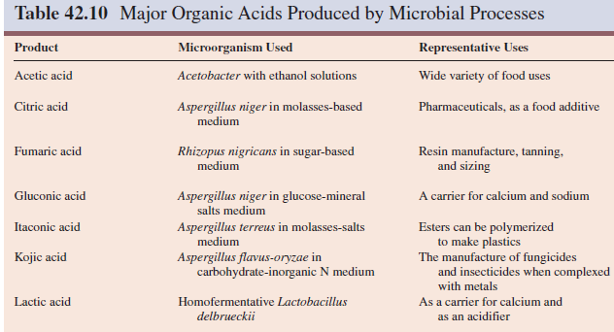

Slide 5
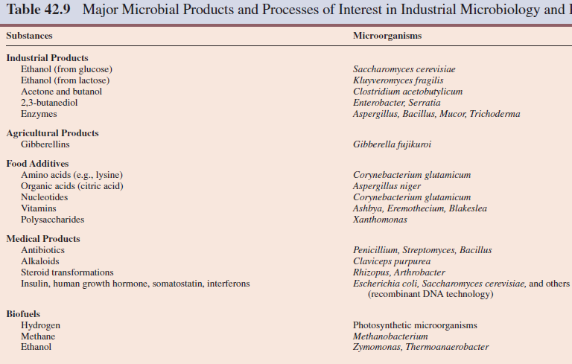

Slide 6
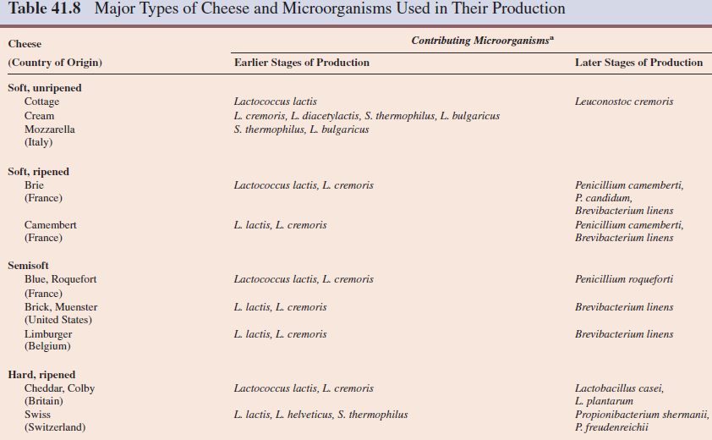

Slide 7
