Slide 1
Good Laboratory Practices
Prepare well for each lab session –Principle and methodology
Be on time
Be organized
Wear shoes
Work patiently
Clean lab coats- in case of a spill- autoclave lab coats-then wash
Wash hands before entering the lab and leaving the lab with detergent and dry them
Disinfect workbench properly by wiping it with cotton swabs saturated with 70-90% ethanol, before and after work
Keep working area clear and clutter freeof everything other than things required for work and a record book –no purses, books, papers, bags etc.
Never eat, drink, apply cosmetics or lip balm, handle contact lenses or take medication in the laboratory.
Never place pencil, marker etc. In your mouth

Slide 2
Live culture spill: cover the entire spill area with dis-infectent (lysol 1:500, phenol 1:100, clorox bleach 10%)
If there is personal injury-cut or burn –inform instructor and go for first aid
Tie long hair, avoid unnecessary movement and talking.
Be very very careful of burners and turn them off when not in use
All microbial cultures should be handled as being potentially pathogenic
Waste papers and contaminated glassware should be kept in provided space
No mouth pipetting ever in the lab
Disinfect incubators, fridges etc regularly

Slide 3
Do not open anything with mouth or teeth, no testing any lag material orally
Open all containers away from your face, nose, eyes
If at all you have to smell something, smell some vapours by fanning with your hands.
always switch off microscopes in between experiments when you are not using it.
Never look directly into a tube and never point an open tube towards your own or neighbour’s face
No eatables in lab fridges
Shut down everything before leaving lab
Use tray to transport any lab material
Use gloves whenever instructed
Use procedures that generate minimum aerosoles
Never walk barefoot in lab

Slide 4
Proper maintenance and cleaning of autoclaves
Ensure aseptic conditions in the lab
Keep culture tubes in upright position
Label all plates, tubes, cultures properly
Return everything to its original position after use
Always clean microscope-stage, eyepiece, objective lenses before and after use
Always perform exercise in sequence
Keep doors, windows, fans etc off while performing inoculations
Record your data in ink and draw protocols, sketches and diagrams in pencil
Proper upkeep of lab record book-very very Imp.

Slide 5
Glassware cleaning:
New glassware: TT, flasks, PD, pipetts, glass slides, coverslips etc: dip in teepol or liq detergent solution, heat to boil-rinse in clean water
Used glassware: autoclave, discard the waste in assigned bin ---dip in detergent solution – wash---rinse with distilled water
Used slides and coverslips : dip in teepol or liq detergent solution, heat to boil-rinse in clean water
In case of Accident:
Report to instructor
Burn: apply ice, keep dipping in ice cold water
Cut/abrasion : clean with antiseptic, bandage
Chemical Spill: keep wash the affected area in running water
Large spill: shower
Acid burn : wash with detergent extensively (neutralizing effect)

Slide 6
Fire
Gas leak: open doors, windows, check all gas burners and pipes
Do not switch on any electrical switch
Minor fire: smoother with towel or book
Larger fire: use fire extinguishers, if unable to control: raise alarm: turn off all gas burners, unplug electrical equipment and evacuate the lab: keep on raising alrm
Disposal of broken glass ware:
Dont pick it up with bare hand: sweep and pick up using dust pan
Place in assigned container

Slide 7
A biosafety cabinet (BSC) — also called a biological safety cabinet or microbiological safety cabinet — is an enclosed, ventilated laboratory workspace for safely working with materials contaminated with (or potentially contaminated with) pathogens requiring a defined biosafety level

Slide 8
Biohazard
An agent of biological origin that can produce deleterious effects on humans i.e. MOs, toxins and allergens
Biosafety
Application of knowledge, techniques, equipments to prevent personal, lab, environmental exposure to potentially infectious agents or biohazards
Biosafety defines containment conditions in which an infectious agent can be safely manipulated
Biohazard waste:
Solid or liq. Waste potentially contaminated with biological agents that can cause inf. in humans, plants or animals:
Eg:1. Zoonotic vectors used in research
2. cultures used in research (human, animal or plant pathology related)
3. GMO
4. Hospital waste : syringes, any disposable accessories used in invasive procedure, organs, tissues, fetus, etc.

Slide 9

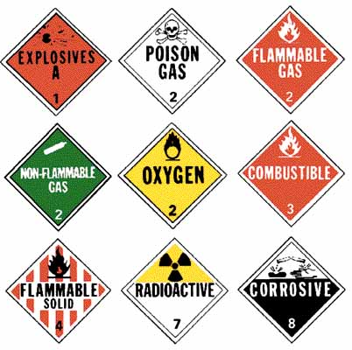
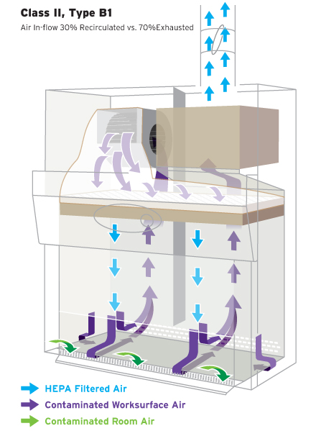
Chemical hazard
Radiation hazard

Slide 10
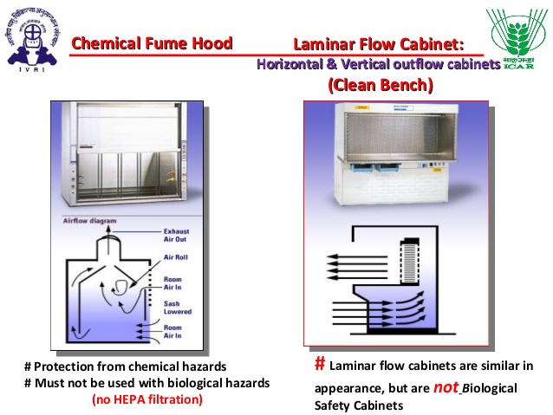

Slide 11
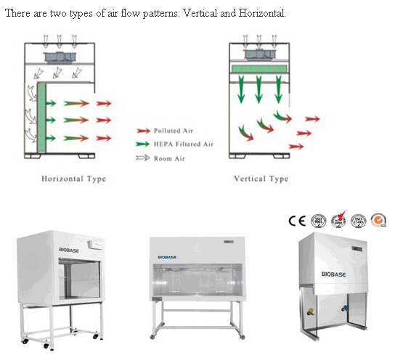
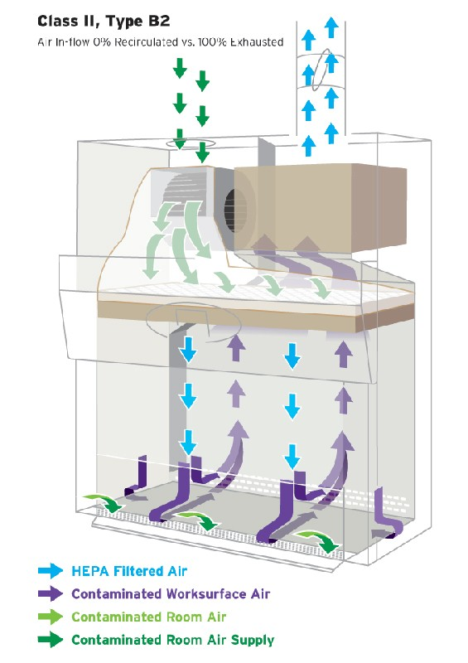

Slide 12
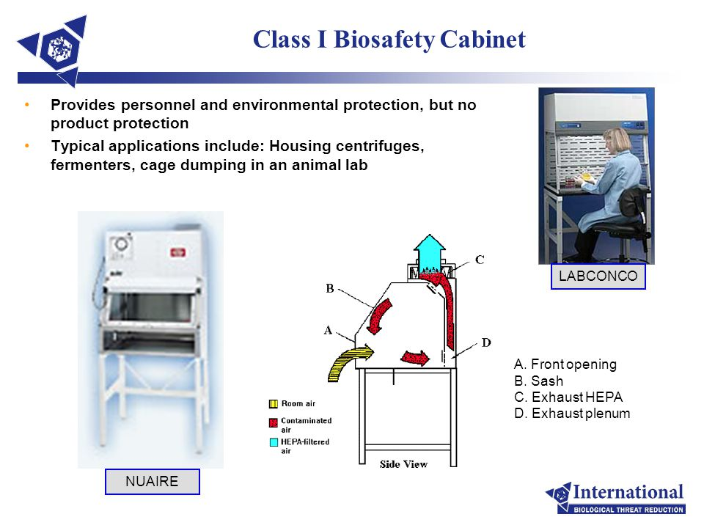

Slide 13
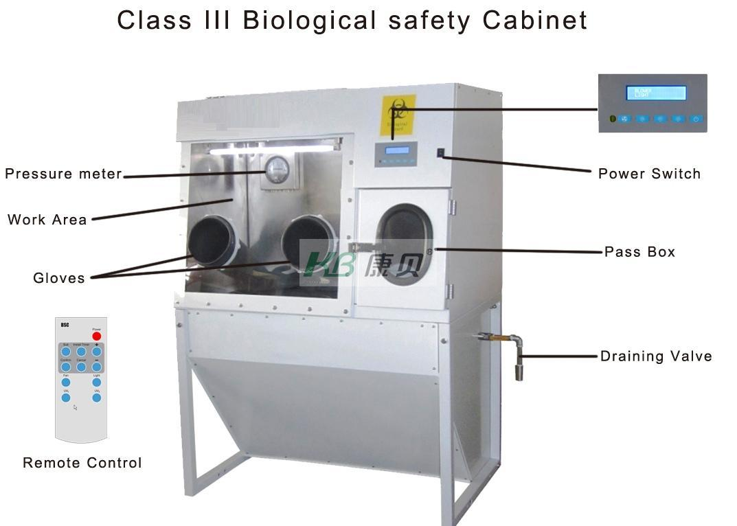

Slide 14
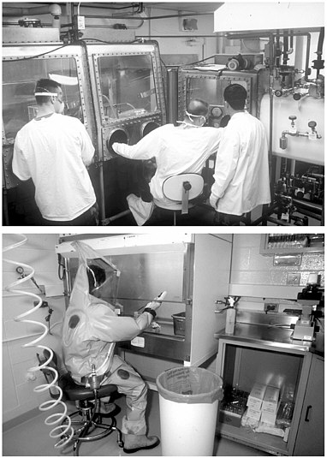

Slide 15
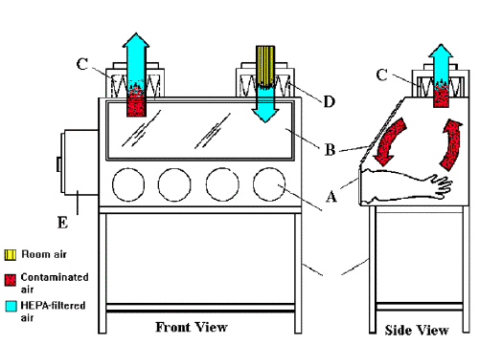

Slide 17
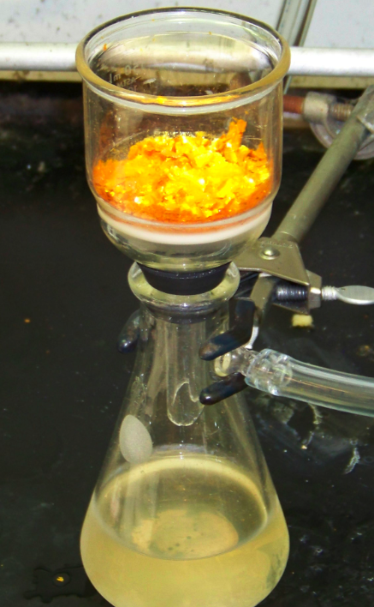
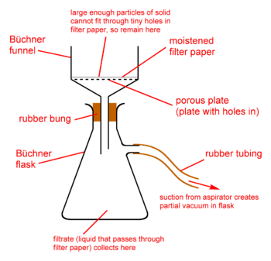

Slide 18
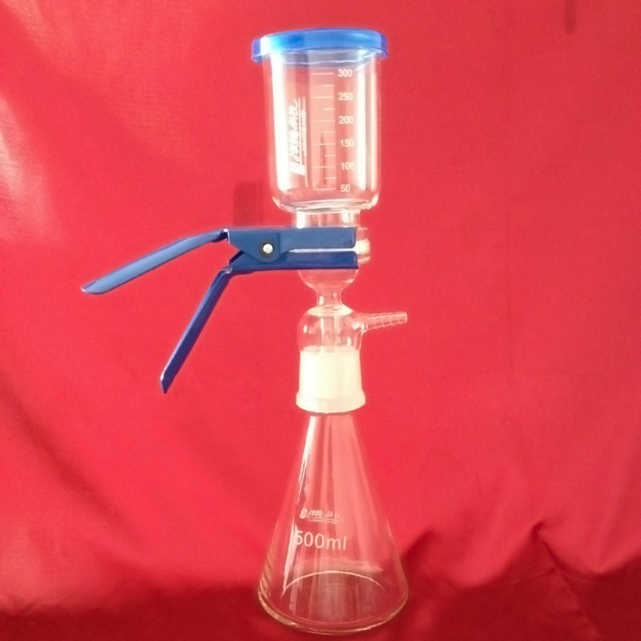
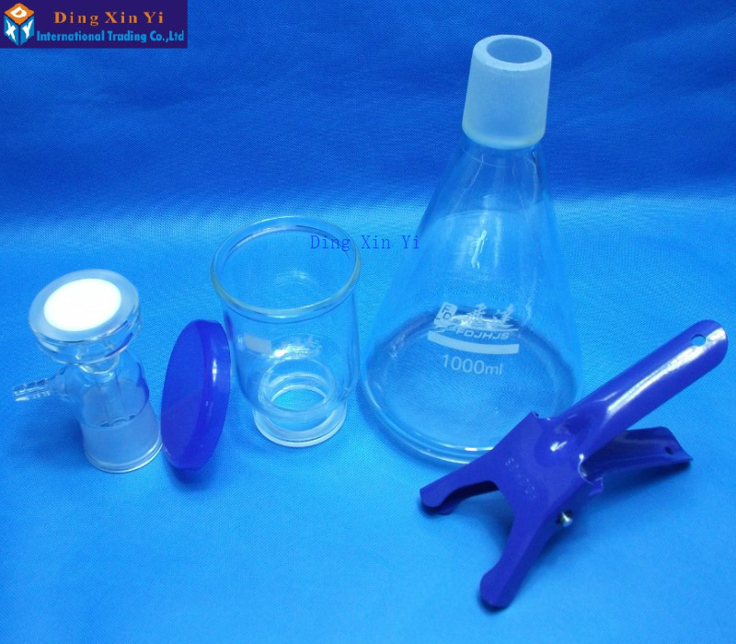

Slide 19
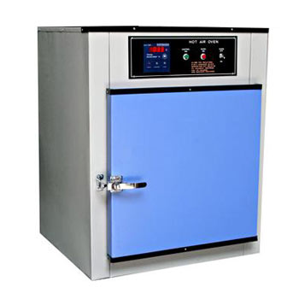
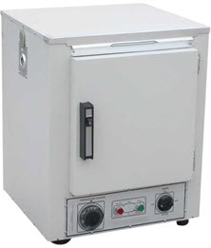
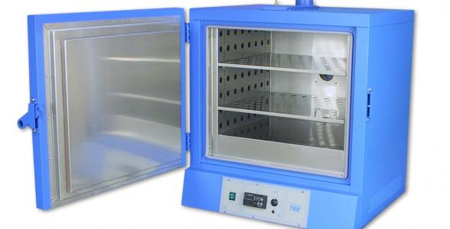

Slide 20
laboratory workers should protect their street clothing from contamination by wearing appropriate garments (eg, gloves and shoe covers or lab shoes) when working in Biosafety Level-2 (BSL-2) laboratories.
In BSL-3 laboratories the use of street clothing and street shoes is discouraged; a change of clothes and shoe covers or shoes dedicated for use in the lab is preferred.
BSL-4 requires changing from street clothes/shoes to approved laboratory garments and footwear.
When utilizing sharps in the laboratory, follow " Bloodborne Pathogens standard requirements. Needles/syringes/other sharps should be restricted in laboratories where infectious agents are handled. If you must utilize sharps, consider using safety sharp devices or plastic rather than glassware. Never recap a used needle. Dispose of syringe-needle assemblies in properly labeled, puncture resistant, autoclavable sharps containers.
Handle infectious materials as determined by a risk assessment. Airborne transmissible infectious agents should be handled in a certified Biosafety Cabinet (BSC) appropriate to the biosafety level (BSL) and risks for that specific agent.
Ensure engineering controls (e.g., BSC's, eyewash units, sinks, and safety showers) are functional and properly maintained and inspected.

Slide 21
Store all biohazardous materials securely in clearly labeled, sealed containers.
Storage units, incubators, freezers or refrigerators should be labeled with the Universal Biohazard sign when they house infectious material.
Doors of all laboratories handling infectious agents and materials must be posted with the Universal Biohazard symbol, a list of the infectious agent(s) in use, entry requirements (e.g., PPE) and emergency contact information.
. Avoid the use of aerosol-generating procedures
Tightly cap tubes prior to centrifuging or vortexing; Allow aerosols to settle prior to opening tubes, equipment; Open tubes or equipment inside a containment device whenever feasible; Shield instruments or activities that can emit splash or splatter.
Use disinfectant traps and in-line filters on vacuum lines to protect vacuum lines from potential contamination.

Slide 22
Proper maintenance and cleaning of autoclaves
Ensure aseptic conditions in the lab
Keep culture tubes in upright position
Label all plates, tubes, cultures properly
Return everything to its original position after use
Always clean microscope-stage, eyepiece, objective lenses before and after use
Always perform exercise in sequence
Keep doors, windows, fans etc off while performing inoculations
Record your data in ink and draw protocols, sketchesand diagrams in pencil
Proper upkeep of lab record book-very very Imp.

Slide 23
Follow the laboratory biosafety plan for the infectious materials you are working with and use the most suitable decontamination methods for decontaminating the infectious agents you use.
Know the laboratory plan for managing an accidental spill of pathogenic materials. Always keep an appropriate spill kit available in the lab.
Clean laboratory work surfaces with an approved disinfectant after working with infectious materials. The containment laboratory must not be cluttered in order to permit proper floor and work area disinfection.
Never allow contaminated, infectious waste materials to leave the laboratory or to be put in the sanitary sewer without being decontaminated or sterilized. When autoclaving use adequate temperature (121 C), pressure (15 psi), and time, based on the size of the load. Also use a sterile indicator strip to verify sterilization. Arrange all materials being sterilized, so as not to restrict steam penetration.
When shipping or moving infectious materials to another laboratory, always use U.S. Postal or Department of Transportation (DOT) approved, leak-proof sealed and properly packed containers (primary and secondary containers).
Avoid contaminating the outside of the container and be sure the lid is on tight. Decontaminate the outside of the container before transporting. Ship infectious materials in accordance with Federal and local requirements.
Report all accidents, occurrences and unexplained illnesses to your work supervisor and the Occupational Health Physician. Understand the pathogenesis of the infectious agents you work with.
Think safety at all times during laboratory operations.
Remember, if you do not understand the proper handling and safety procedures properly, do not work with the infectious agents or materials

